Slide 1



Laboratory 2:
Inertial Navigation and PDR
Dr. Weisong Wen, Assistant Professor
Trustworthy AI and Autonomous Systems Laboratory (TAS Lab)
The Hong Kong Polytechnic University Nov. 3, 2025
1 / 10

Slide 2
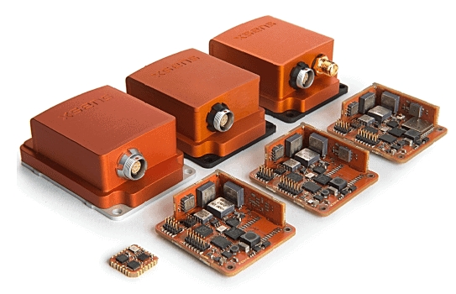

Background: Why IMU?
What is IMU?
— Inertial Measurement Units containing accelerometers and gyroscopes
— No external signals required (unlike GNSS)
— Measures acceleration and angular rates to compute position
— Foundation for autonomous navigation in GNSS-denied environments
Why study Inertial Navigation and PDR?
— Essential for indoor positioning where GNSS fails
— Critical backup for autonomous vehicles and drones
— Enables seamless indoor/outdoor navigation
— Key technology for smartphones, wearables, and IoT devices
One of the most common sensors

Slide 3



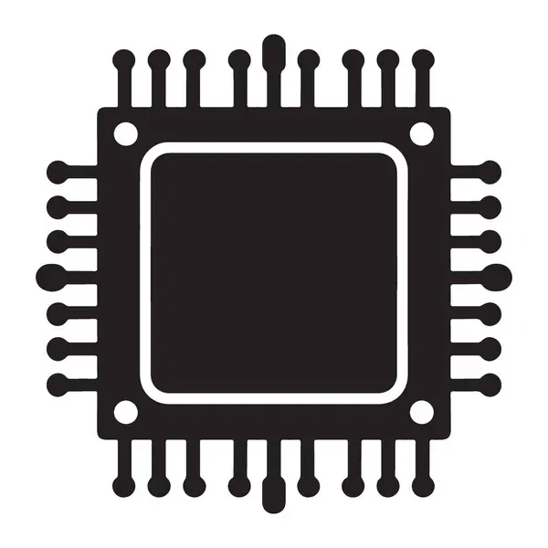
Objective
Core Learning Goals
Gain experience with IMU-based pedestrian positioning
Learn how to do data collection with your own smartphone
Implement Pedestrian Dead-Reckoning (PDR) algorithms
Master adaptive step detection for robust navigation
Understand parameter tuning effects on positioning accuracy
Key Focus Areas
Step-based navigation principles
Dynamic threshold adaptation
Sensor fusion for heading estimation
Real-world positioning challenges
Goal: Accurate trajectory estimation
using smartphone IMU data
2 / 10

Slide 4

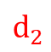
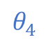
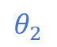

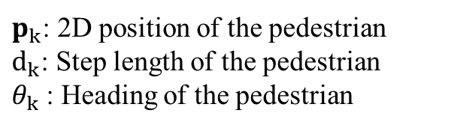

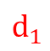
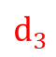


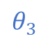

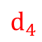
Pedestrian Dead-Reckoning: Fundamentals & Challenges
What is PDR?
A simple step-based navigation algorithm
Estimates position by tracking:
Step detection: when steps occur
Step length: distance per step
Heading: direction of movement
Uses IMU sensors:
Accelerometer: Motion detection
Gyroscope: Orientation tracking
Key Advantages
More robust than continuous integration
Discrete event-driven approach
Better suited for low-quality mobile sensors
No infrastructure requirements
N
$$θ_{3}$$
$$d_{3}$$
$$θ_{4}$$
E
$$d_{2}$$
$$p_{2}$$
$$p_{3}$$
$$d_{4}$$
N
$$θ_{2}$$
$$d_{1}$$
$$p_{4}$$
$$θ_{1}$$
$$p_{1}$$
E
$p_{k}$: 2D position of the pedestrian
$d_{k}$: Step length of the pedestrian
$θ_{k}$: Heading of the pedestrian
3 / 10
Notes:
Step detection: We can know how many steps we took during the experiment
Step length: What is the approximate length of each step?

Slide 5
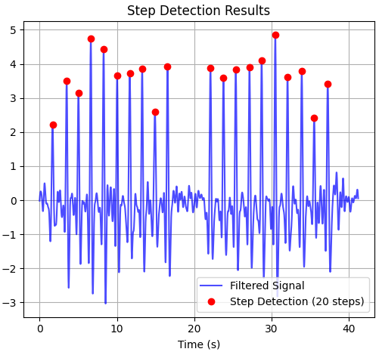
Adaptive Step Detection Algorithm
Mathematical Framework
Signal Processing:
Band-pass filtering (0.5-3Hz human gait range)
Filter out gravity signals below 0.5Hz and disturbances above 3Hz (such as phone vibration, arm shaking, etc.)
Dynamic Threshold Calculation:
threshold(i) = σ(window_{i}) × 0.5
Step Detection Criteria:
a_{filtered}[i] > threshold(i)
a_{filtered}[i] > min peak height
Local maximum condition
Minimum time interval constraint
Adaptive Features:
Dynamic thresholding based on local variance
Robust to different walking styles
Handles varying phone orientations
Filters false positives/negatives
Peak Detection——to detect each step
Step Detection Results
4 / 10
Notes:
You can imagine that every time you lift your foot while walking, the forward acceleration becomes very large, so we can identify the number of steps by detecting the peak in the forward direction.

Slide 6

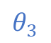
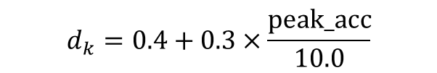
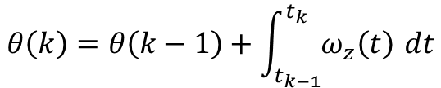

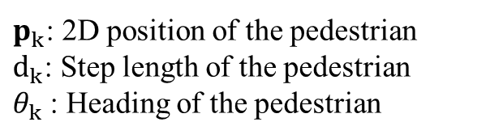
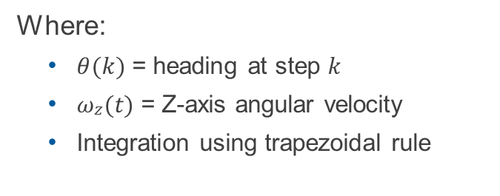
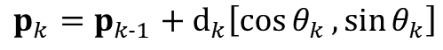
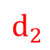

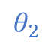
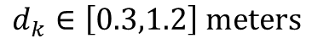
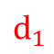
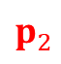
Heading & Step Length Estimation
Adaptive Step Length Model
Empirical Formula (based on the acceleration peak):
$$d_{k}=0.4+0.3×\frac{\text{peak}\text{_}\text{acc}}{10.0}$$
$$θ_{3}$$
Constraints:
$$d_{k}∈\left[0.3,1.2\right] \text{meters}$$
$$d_{2}$$
$$p_{2}$$
N
$$θ_{2}$$
$$d_{1}$$
$$θ_{1}$$
$$p_{1}$$
E
Heading Estimation from Gyroscope Trajectory Calculation
Integration Method:
$$p_{0}$$
$$p_{k}=p_{k−1}+d_{k}\left[\cos{θ_{k}},\sin{θ_{k}}\right]$$
$$θ\left(k\right)=θ\left(k−1\right)+\int_{t_{k−1}}^{t_{k}}{ω_{z}\left(t\right)} dt$$
$p_{k}$: 2D position of the pedestrian
$d_{k}$: Step length of the pedestrian
$θ_{k}$: Heading of the pedestrian
Where:
$θ(k)$ = heading at step $k$
$ωz(t)$ = Z-axis angular velocity
Integration using trapezoidal rule
5 / 10

Slide 7


Laboratory Procedure: Data Collection & Setup
Simulation
Implement the repository and install IDE, Python and required libraries
Run code with provided data
Collect your own data
Open the provided HTML tools
Collect your own gait data and save it as .csv
Optimization
Parameter Tuning
Performance Optimization
6 / 10

Slide 8
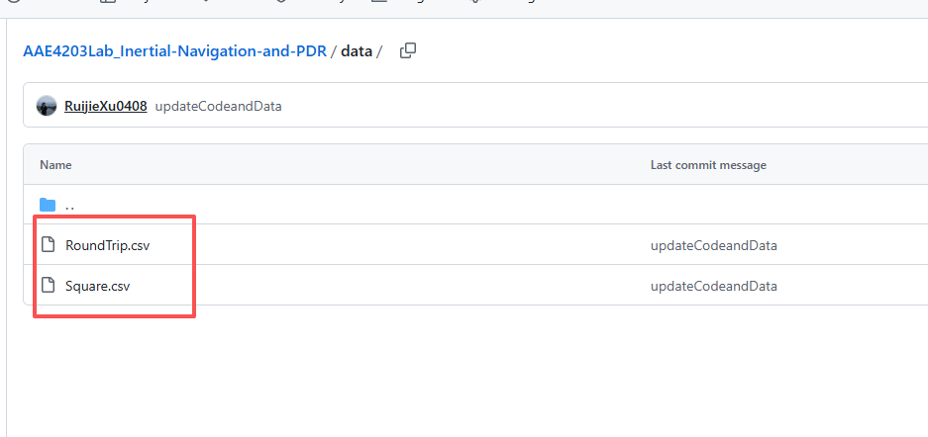
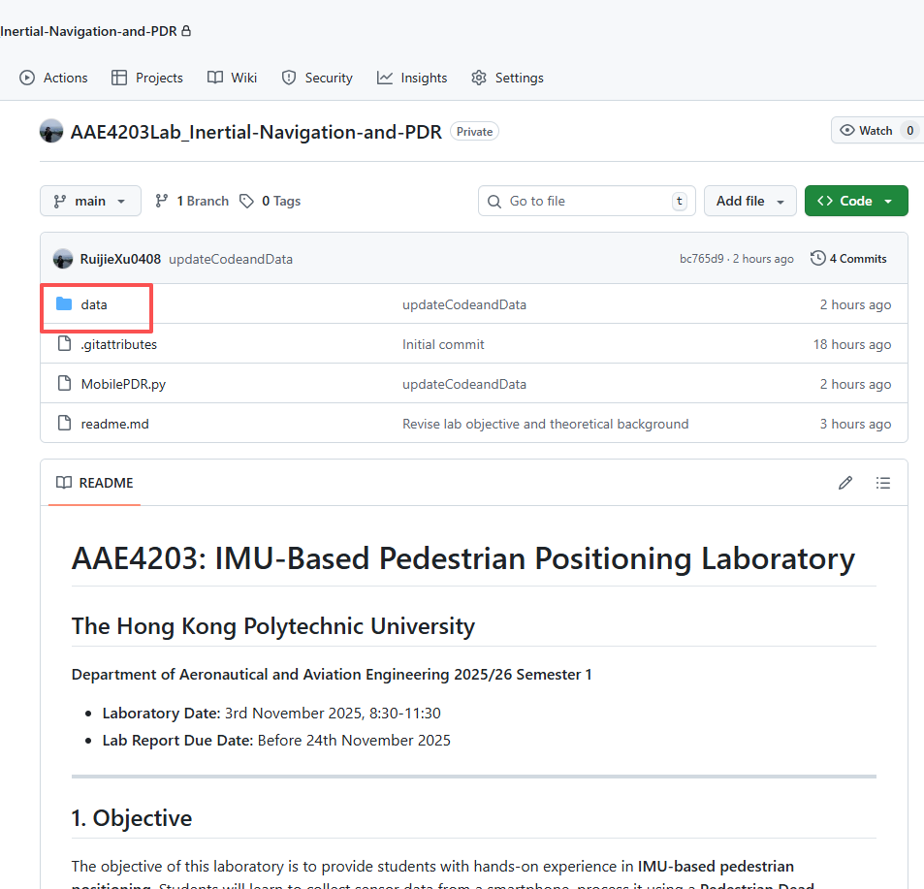
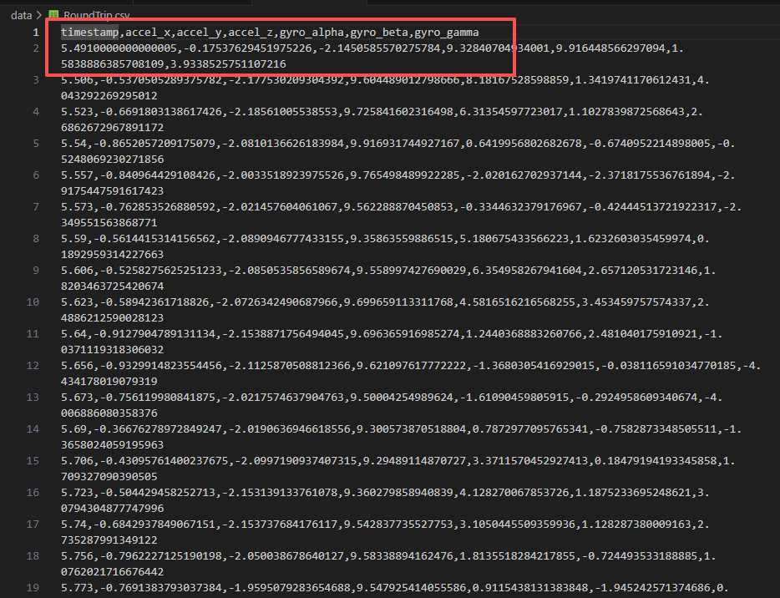
Laboratory Procedure: Data Collection & Setup
Chosen 1: Demo data from lab repository
Choose one of it
6 / 10

Slide 9
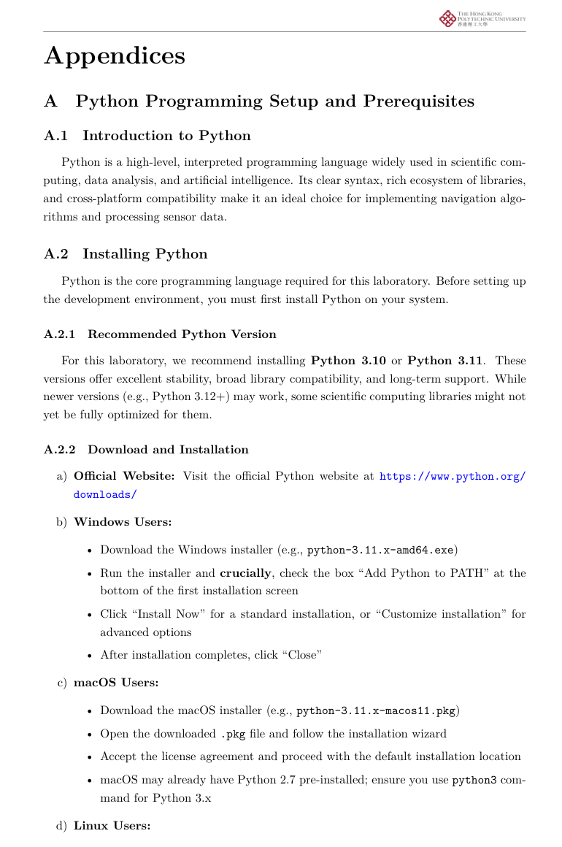
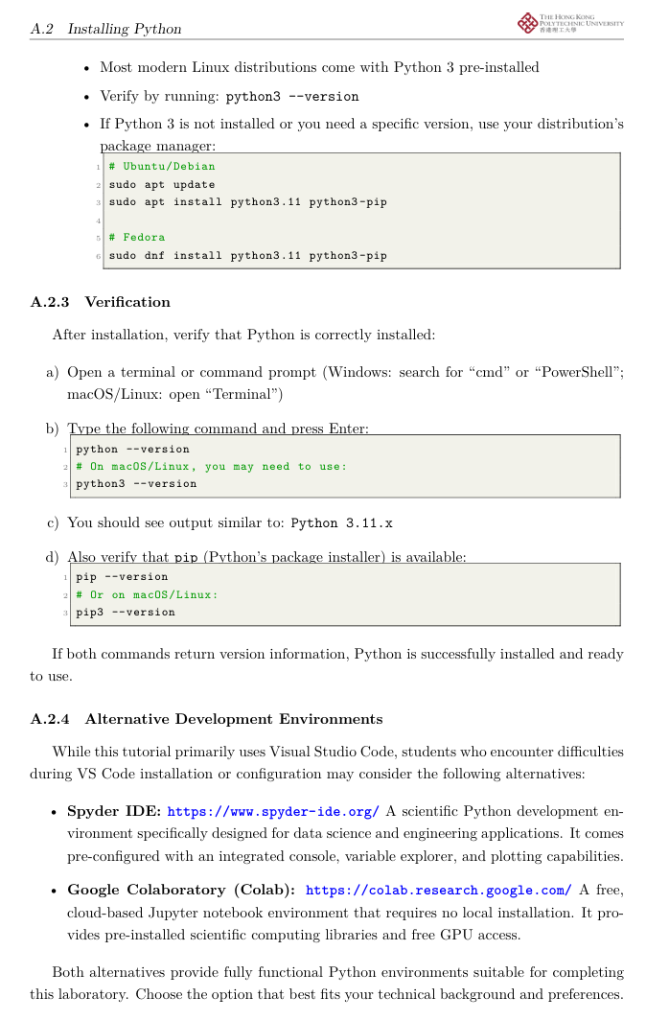
Laboratory Procedure: Data Collection & Setup
Chosen 1: Demo data from lab repository
6 / 10

Slide 10
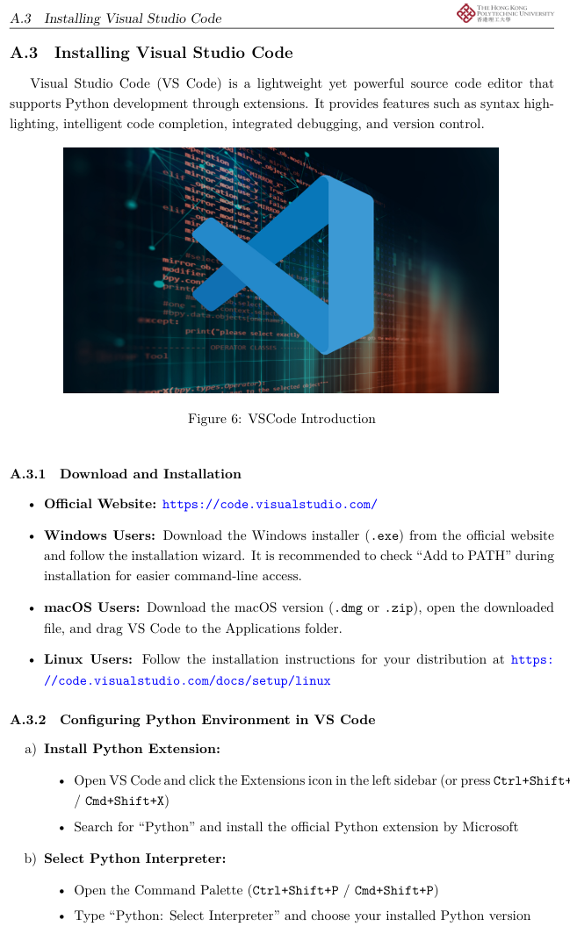
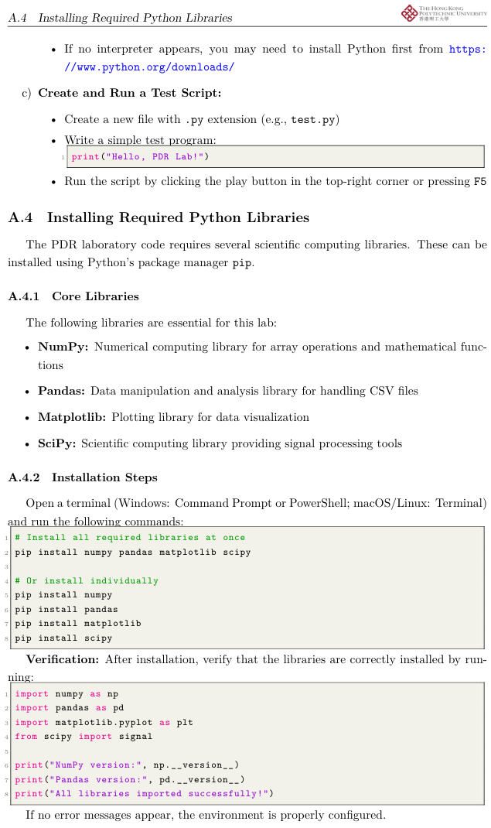
Laboratory Procedure: Data Collection & Setup
Chosen 1: Demo data from lab repository
6 / 10

Slide 11

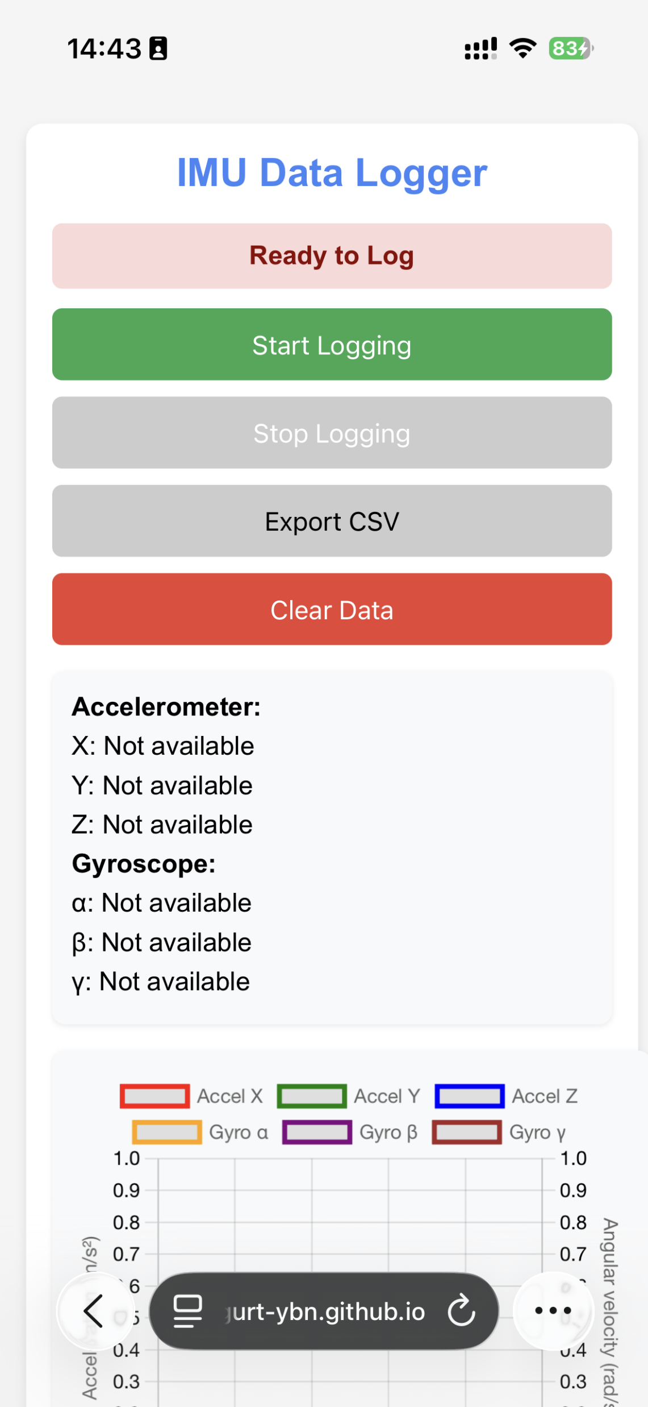
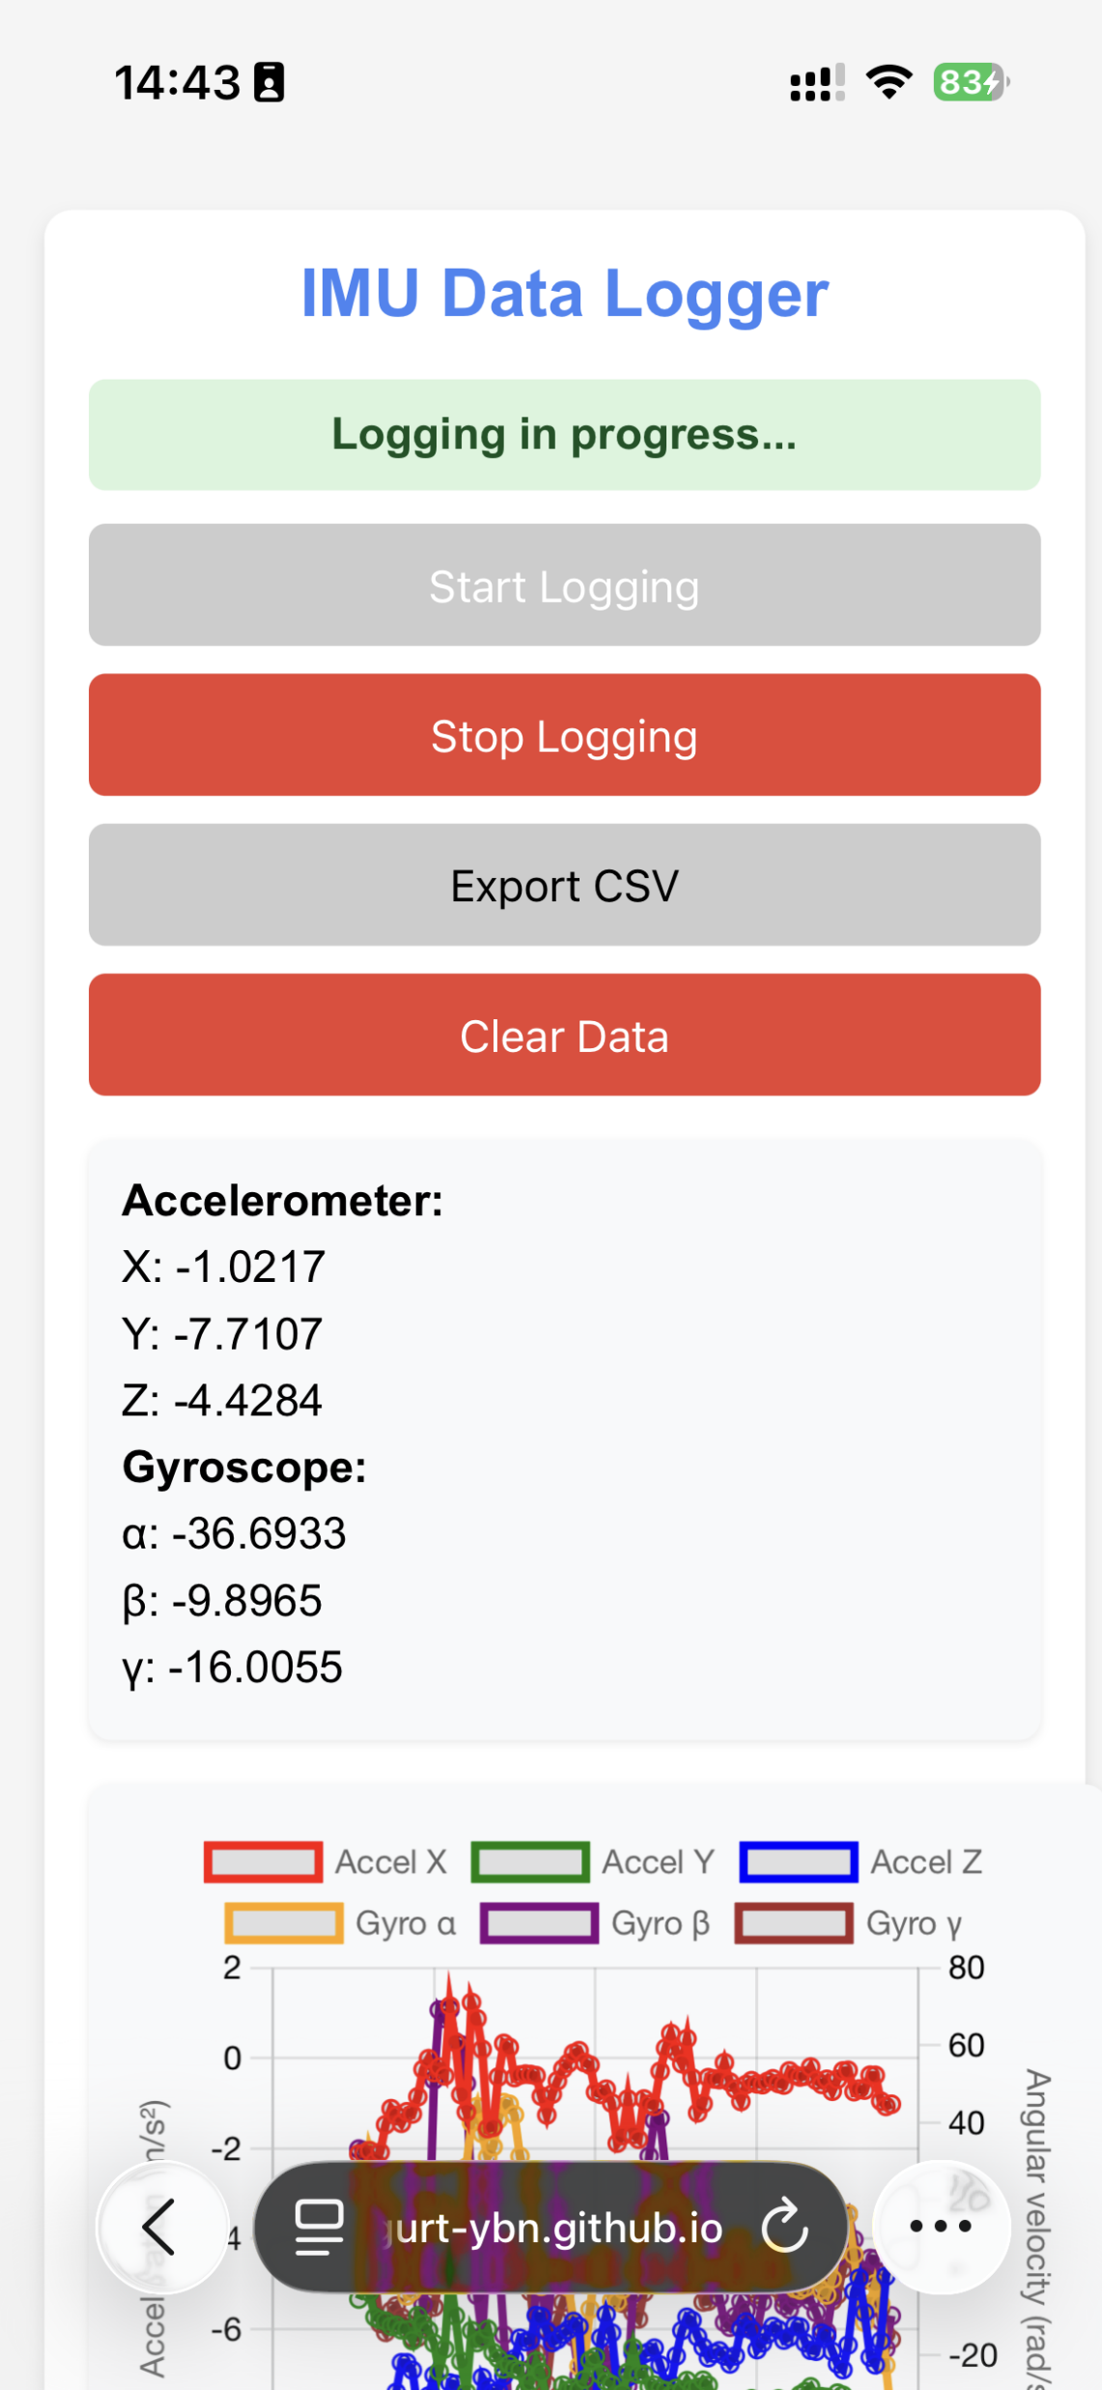
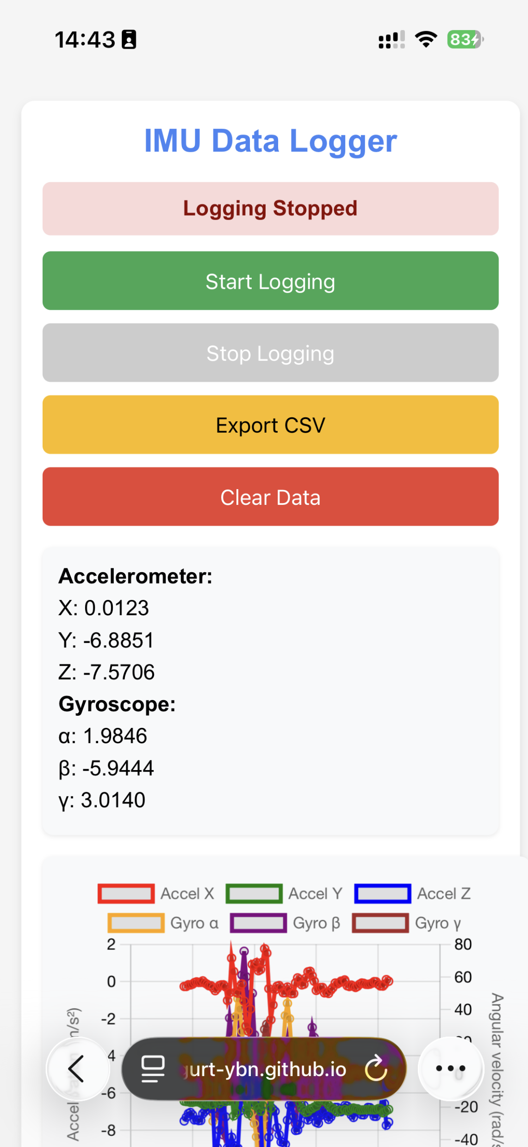
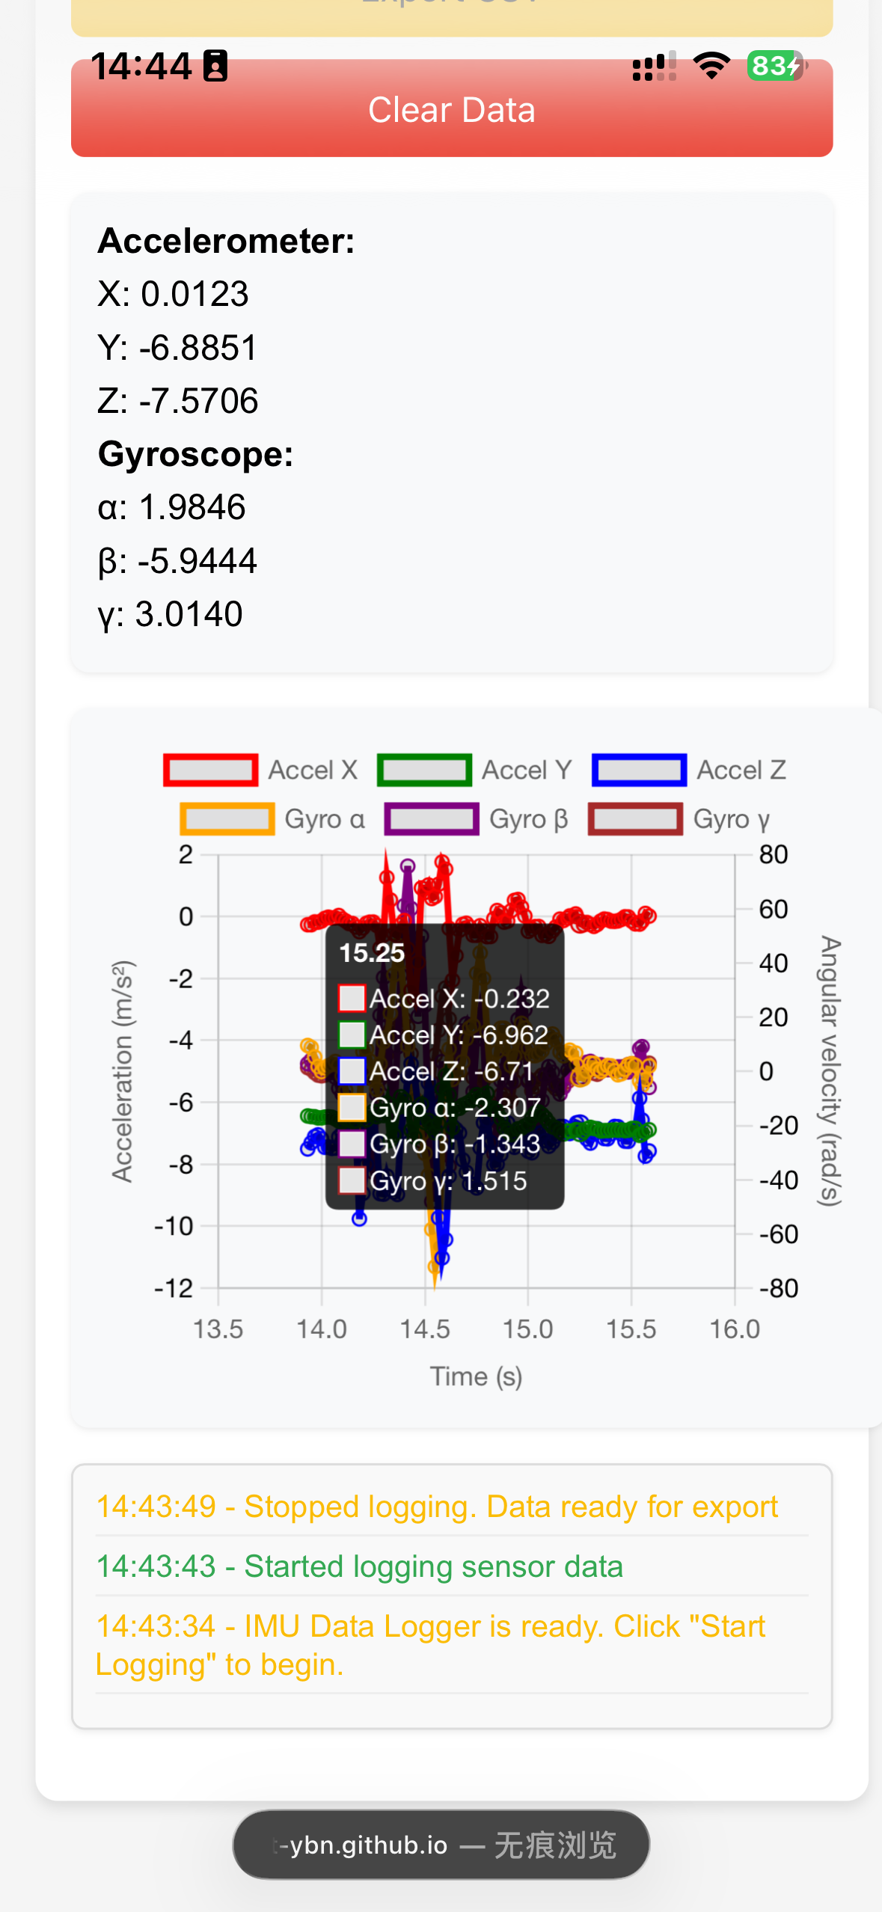
Laboratory Procedure: Data Collection & Setup
Chosen 2: Collect data on your own through HTML
4. Export the data to your laptop
3. Click to stop when finishing
Keep your phone and body in relative rest (相對靜止)
1. Click to start
Data Collection
Use provided HTML IMU collection tool
Maintain consistent phone orientation
Record at stable sampling rate
Export as CSV with format
2. Collect the data and view it
7 / 10

Slide 12
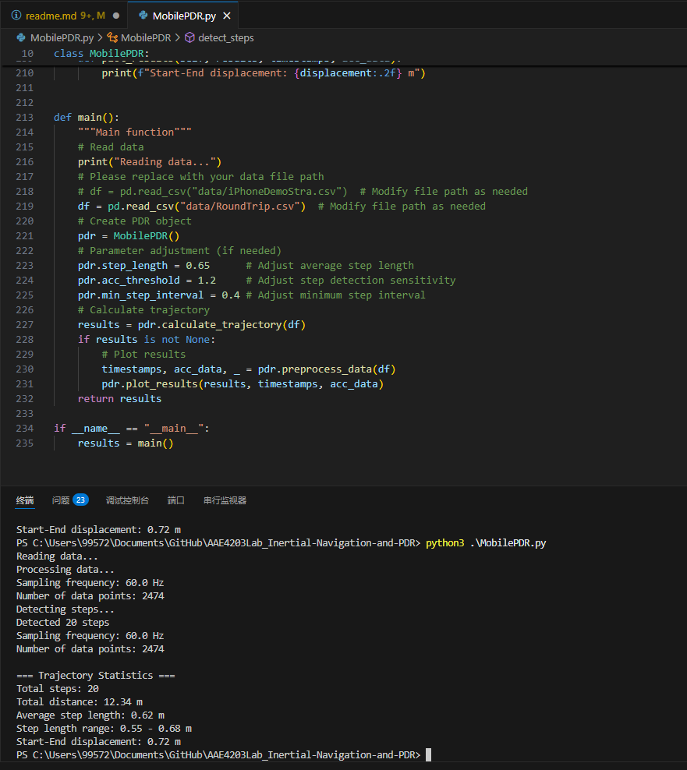
Parameter Tuning & Performance Optimization
Key Tunable Parameters
Step Detection Sensitivity:
1. Replace it by your own data path
1
2
3
pdr. acc_threshold = 1.2
# Peak detection threshold
pdr. min_step_interval = 0.4
# Min time between steps
Step Length Parameters:
pdr. step_length = 0.65
# Average step baseline
min_peak_height = 1.0
# Absolute minimum threshold
1
2
3
Signal Processing:
1
2. Run the python code
window_size = int (0.5 * fs)
3. View the results and plot
# Dynamic threshold window
8 / 10

Slide 13
Thinking Question:
Research Question
Does the orientation of the smart-phone during data collection affect PDR algorithm performance? Why or why not?
How does heading estimation affect the performance of the PDR algorithm? What methods can be used to improve the accuracy of heading estimation?
What improvements can you suggest for the `MobilePDR.py` code provided to improve the positioning accuracy of PDR? (Just give the method, no specific implementation is required)
9 / 10

Slide 14
Q&A
Thank you for your attention
Let’s Q&A!
Dr. Weisong Wen, Assistant Professor
Trustworthy AI and Autonomous Systems Laboratory (TAS Lab)
The Hong Kong Polytechnic University Nov. 3, 2025
10 / 10

Slide 15

Appendices
Programming with AI Tools
Available AI Models for Programming Assistance
PolyU GenAI – Internal AI platform provided by The Hong Kong Polytechnic Uni versity.
DeepSeek – Web-based AI coding assistant developed in China, utilizing reinforce ment learning techniques to improve code suggestions.
Grok – AI coding assistant developed by xAI for code generation and intelligent suggestions.
GitHub Copilot – AI-poweredcodecompletion tool developed by GitHub, integrated into mainstream IDEs.
ChatGPT – General-purpose large language model from OpenAI, capable of code generation and debugging; may require VPN.
Gemini – AI assistant supported by Google, specializing in programming and techni cal reasoning; may require VPN.
Try to use AI Models to implement your PDR algorithm and data collection tool
9 / 10

Slide 16
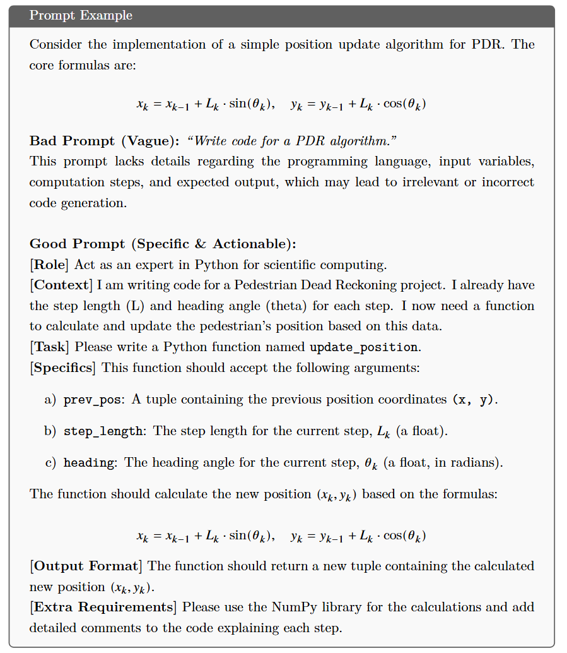
Appendices
Effective Prompt Engineering
The quality of AI-generated code is highly dependent on the clarity and completeness of the prompt provided.
Assign a Role: Instruct the AI to act as an expert in a specific domain, e.g., scientific computing in Python.
Provide Context: Describe the project, its objectives, and the current stage of development.
Define the Task: Clearly specify the functionality or computation to be implemented.
Provide Specific Details: Include all necessary information such as mathematical formulas, variable names, and data structures.
Specify Output Format: Indicate the desired format of the code, such as a function, class, or complete script.
Add Additional Requirements: Request the use of specific libraries, inclusion of comments, or explanation of the code logic.
9 / 10

Slide 17
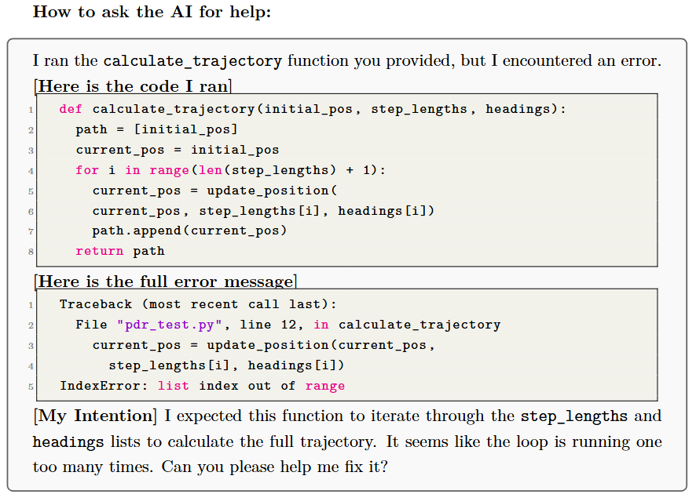
Appendices
Collaborative Debugging with AI
The Golden Rule of AI Debugging
Verification and Refinement
The Code You Ran: Especially the part that caused the error.
The Full Error Message: Copy the entire error traceback from beginning to end.
Your Intention: Briefly explain what you expected the code to do.
Verification of Test Data: Use a simple dataset with known expected outputs tovalidate the correctness of the algorithm, either manually or automatically.
Comparison of Results: Compare the program output with theoretical expectationsor manually computed results to ensure consistency and correctness. Any discrepanciesshould prompt a review of the algorithm and its implementation.
Code Refinement and Optimization: After confirming correctness, students mayrequest further improvements, such as optimizing for performance, refactoring for read-ability, or enhancing maintainability.
Documentation and Summary: Maintain a detailed record of prompts, AI re-sponses, and final working code. This serves both as project documentation and avaluable learning resource.
9 / 10

